Slide 1
Seating & Positioning – Qualifying Diagnosis (DX) Process Guide
Document Version | Date of Last Update | Change to Document
V1 | 04/28/2025 | N/A – Initial Publication
This job aid is intended for Funding Specialists to utilize when validating client demographic information against Medicare coverage criteria for coverage of seating and positioning cushions and accessories.
Overview:
Seating and positioning cushions and accessories require specific covered ICD-10 diagnoses (DX) as criterion to meet medical necessity for CMS Coverage. This job aid walks through the process of using our Coding & Pricing Check tool to verify what requirements are met and steps to take if requirements are not met.
Process:
Once coding has been completed in the Detail tab, from this tab, click the Coding & Pricing Check button.
DX Check: The tool displays when there is a component (positioning/skin protection cushion or accessory) in which a required DX is missing from the client’s record in order to meet coverage criteria. If a HCPCs is found missing a required ICD10, additional steps are required per our Credit Policy to determine coverage and/or payment for the component(s).
Review all documentation such as the referral, Face to Face, Progress notes and/or the LMN to verify if the client has a required diagnosis for the requested seating and positioning items.
  If the required diagnosis is found, add the DX to the client demographics in Mobility Advisor.
  If the work order is missing clinical documentation or if the documentation on file does not list the client’s active diagnosis code, then proceed with requesting an active diagnosis list from the physician.

Slide 2
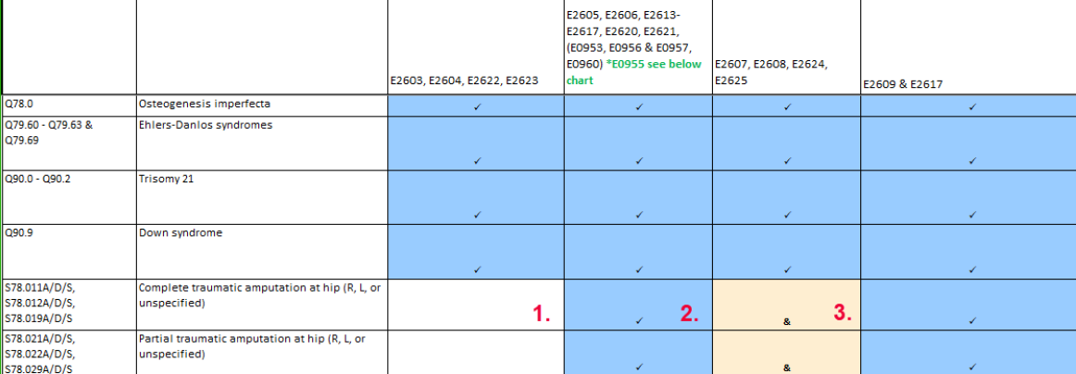
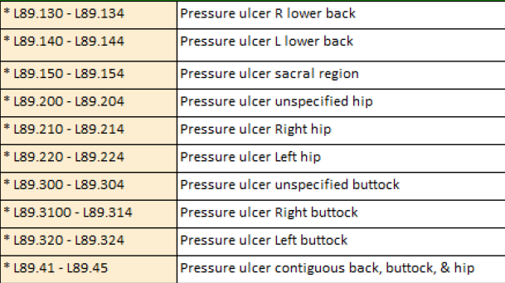
Seating & Positioning – Qualifying Diagnosis (DX) Process Guide
Remember, the physician’s F2F face is going to carry the most weight, the face to face and LMN should agree on the diagnosis, and the most relevant Diagnoses must be loaded into the primary locations in Mobility Advisor. For example, if the client has two diagnoses Diabetes and Quadriplegia. Enter Quadriplegia as the primary ICD10 code in MA followed by Diabetes.
4. Once the new ICD10 codes in MA have been confirmed and updated (if appliable), complete another DX check through the Coding & Pricing Check tool or use the Medicare Resource Workbook navigate to the “ICD-10 Cushion & GRP3" tab to re-verify coverage.
The Medicare Resource Workbook will help determine what must be documented within medical records and what the qualifying diagnosis are. To use the workbook, identify the cushion type on the top row, then the beneficiary's diagnosis in the far-left column. The junction in which they meet will inform you if the cushion is covered with that Diagnosis as indicated by a checkmark and blue highlight.
If there is a “&” symbol present for that Diagnosis and cushion combination, this Diagnosis alone will not meet the needs unless accompanied by a second diagnosis as shown below.

Slide 3
Seating & Positioning – Qualifying Diagnosis (DX) Process Guide
5. Determine final coverage once all diagnoses have been secured:
  If the ICD10 code(s) does support the seating and positioning items:
    Funding Specialist to process work order through normal funding process ensuring medical need is met.
  If the ICD10 code(s) does not support the seating and positioning items:
    Funding Specialist to contact the client/caregiver via phone or email & discuss the payer diagnosis requirements that have not been met for coverage.
    Confirm with the client that the ICD10 codes in MA are accurate. If the client mentions a DX that is not listed in the clinical documentation that would meet criteria, then request that the client contacts their physician to have their records updated.
    Provide client with the following options:
      Change in Product: Involve the ATP and possibly PT to provide different recommendations based on the client’s specific medical need and plan coverage.
        If a product change is determined, identify if an updated LMN, LMN Addendum and/or a revised RX/DWO will be required and rename documentation in the order accordingly.
        If a client requires re-evaluation by ATP and/or Therapist, notify the ATP, client, and/or therapist. Then, using the Request Help feature on the Main Page of the order, request to “Evaluation Reset”, to return the order to the proper evaluation scheduling work queue.
or
      Client-Paid Upgrade: If a client does not meet the Medicare medical coverage criteria for an item, and requests an upgraded item, NSM will charge the client for the upgraded item provided or seek alternate funding. A properly completed ABN must be obtained, the GA modifier is used to indicate a noncovered upgrade, and NSM Pricing Policy is utilized to determine the client responsibility amount of the upgrade.
        Refer to Policy F-300 Medicare Upgrade Guidelines and the How to Book an Upgrade job aid on WNSM for further instructions on what steps to complete in Mobility Advisor.

