Slide 1
WNSM
Administrator and Editor Training
May 2022

Slide 2
1
Administering the Intranet

Slide 3
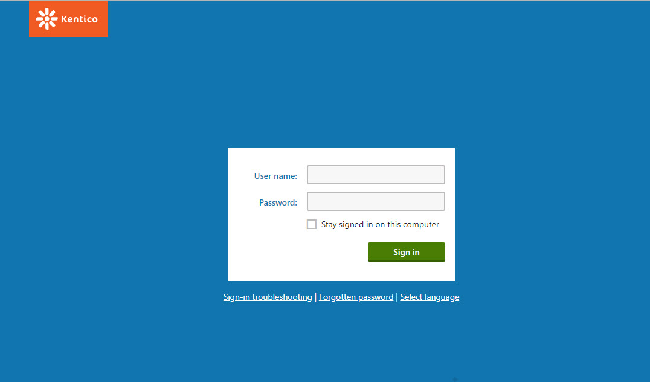
Logging in
URL: https://wnsm.com/Admin/CMSAdministration.aspx
Username: NSM Email Address (case sensitive)
Password: NSM123!
Check “stay signed in on this computer”

Slide 4
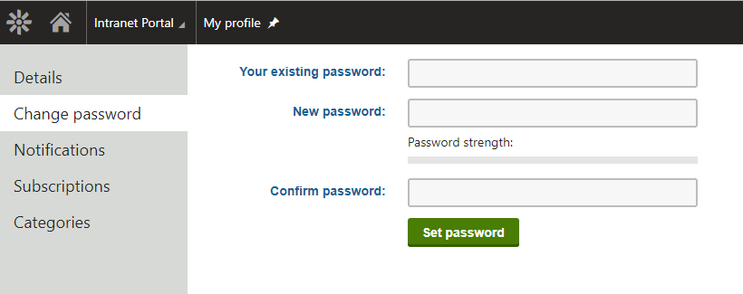
Changing Your Password
To change your password:
From dashboard, click flower to open application list
Search “My profile”
Open My profile dashboard
Click change password in menu
Enter NSM123! as existing
Enter new password
Click “Set password”

Slide 5
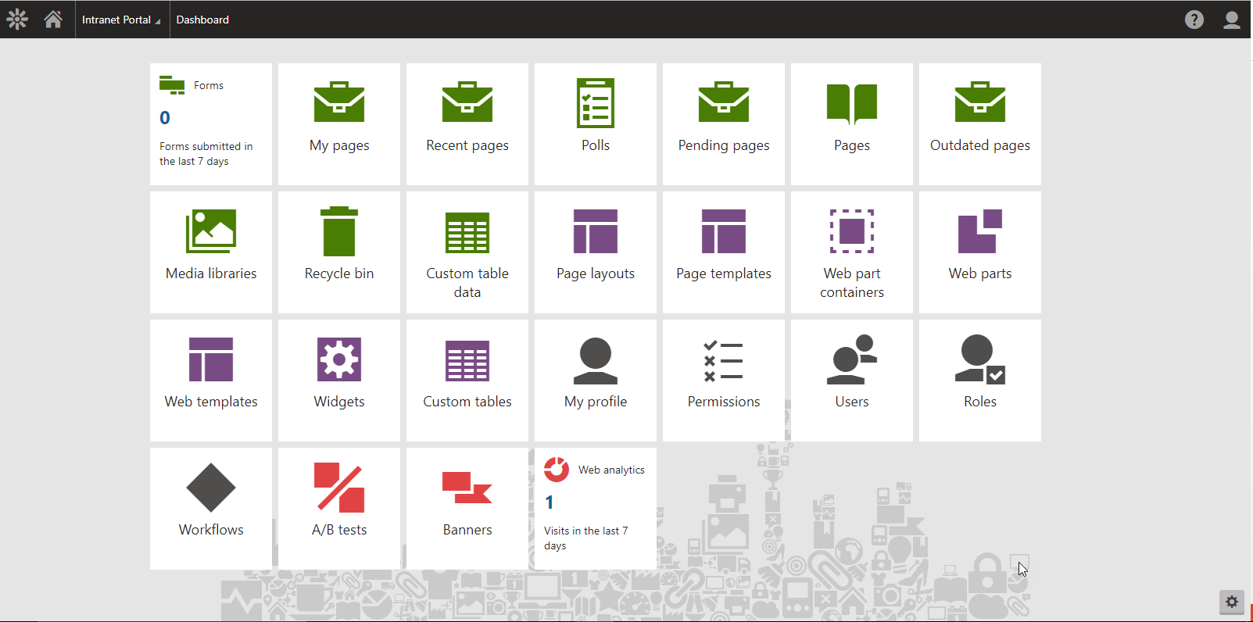
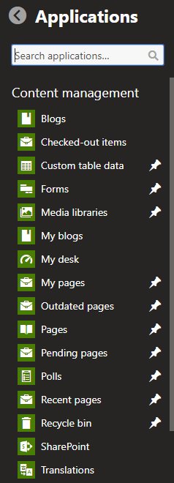
Setting Up Your Dashboard
2
Your Dashboard = Your Home Screen
To Configure Your Dashboard:
Click the gear
Click the flower
Click the applications you want on Dashboard
3
1
Most Common Applications
Pages – the most important application; used to update page content
My Pages – pages the user has edited or created

Slide 6
Workflow Steps
Edit – changes can be made to the page, it’s content, and layout without being visible on the live website. Newly created pages will be placed in the this step.
Published – the page and all of its content are visible on the live website. Editing the page will take it back to the Edit step with the new changes. The page will still remain visible on the live website in its old state before it was edited. When the update version goes through the NSM Workflow and is published again, the live page will be updated with the new changes.
Archived – the page is not visible on the live site. Editing the page will take it back to the Edit step.

Slide 7
2
Adding/Editing Content

Slide 8
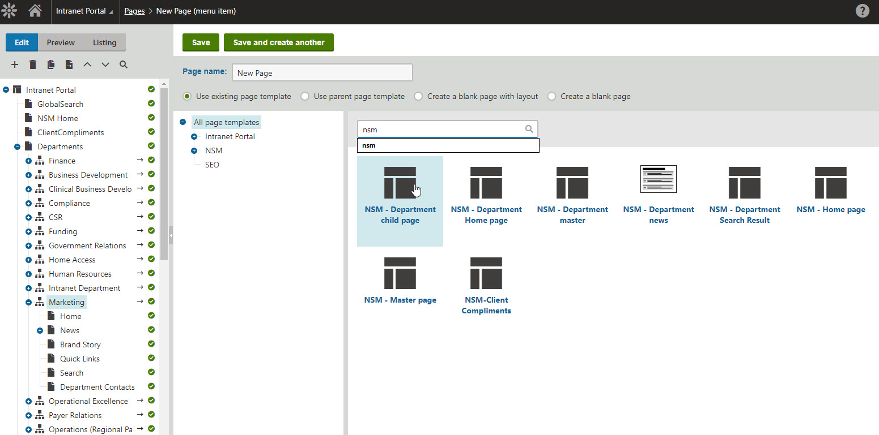
Add a Page to Your Department
Select the desired Department from the Content Tree in the Admin Panel.
Click the + at the top of the Content Tree
Select Page (menu item).
4. Enter a page title. This will appear in the page URL by default and in the content tree.
5. Search for NSM and then choose the NSM Department Child Page template.
6. Click Save. The page will appear in the content tree and will be in the Edit step.
Step 2
Step 6
Step 4
Step 3
Step 5
Step 1

Slide 9
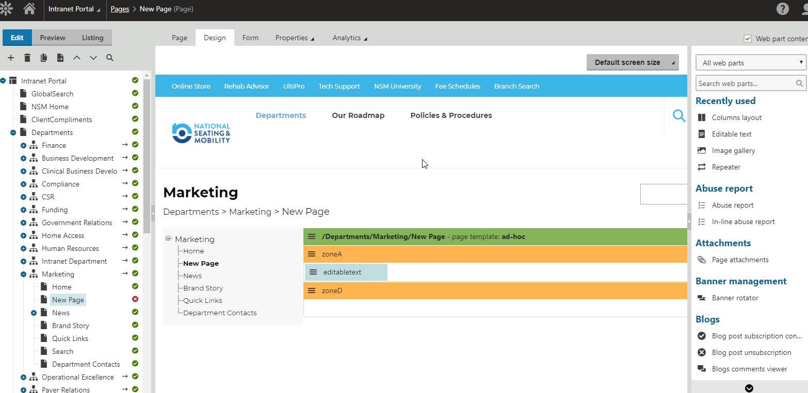
Add Content to Page
After your page has been created, click on the Design tab so you can add the web part that will allow you to add content.
Drag the Editable text web part under zoneA
Once you’ve dropped in the Editable text web part, click Page and begin adding your content.
Step 3
Step 1
Step 2
If you would like to create columns for your text, simply drag the Columns layout into zoneA and repeat septs 2-3.
*Please work only within zoneA – if desire further customization options please reach out to Madelyn (Madelyn.Herbert@nsm-seating.com)

Slide 10
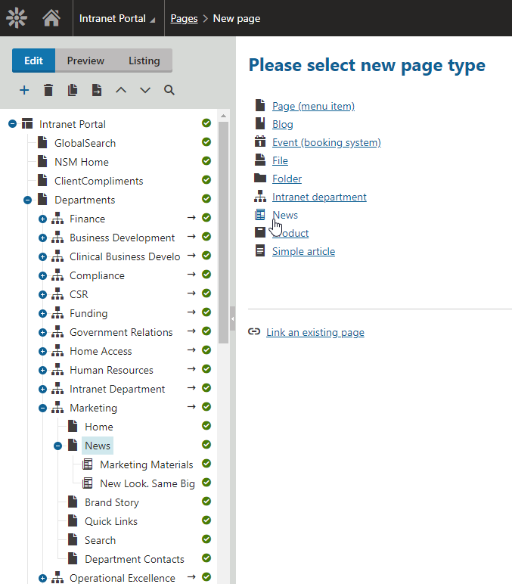
Add News to Your Department
Under your Department in the Content Tree in the Admin Panel, click News
Click the + at the top of the Content Tree
Select News as your page type.
Fill out the form with the information applicable to your news
Select Save.

Slide 11
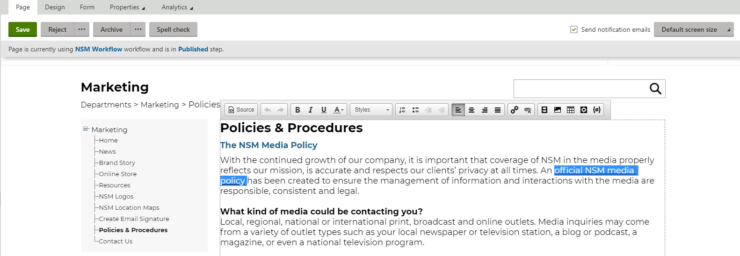
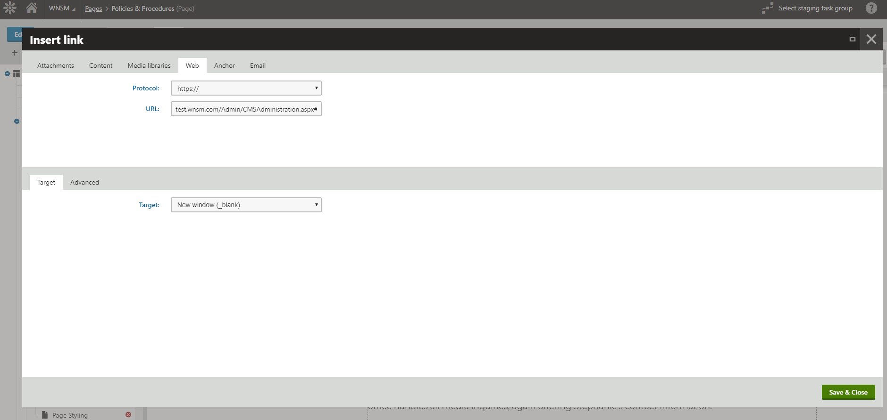
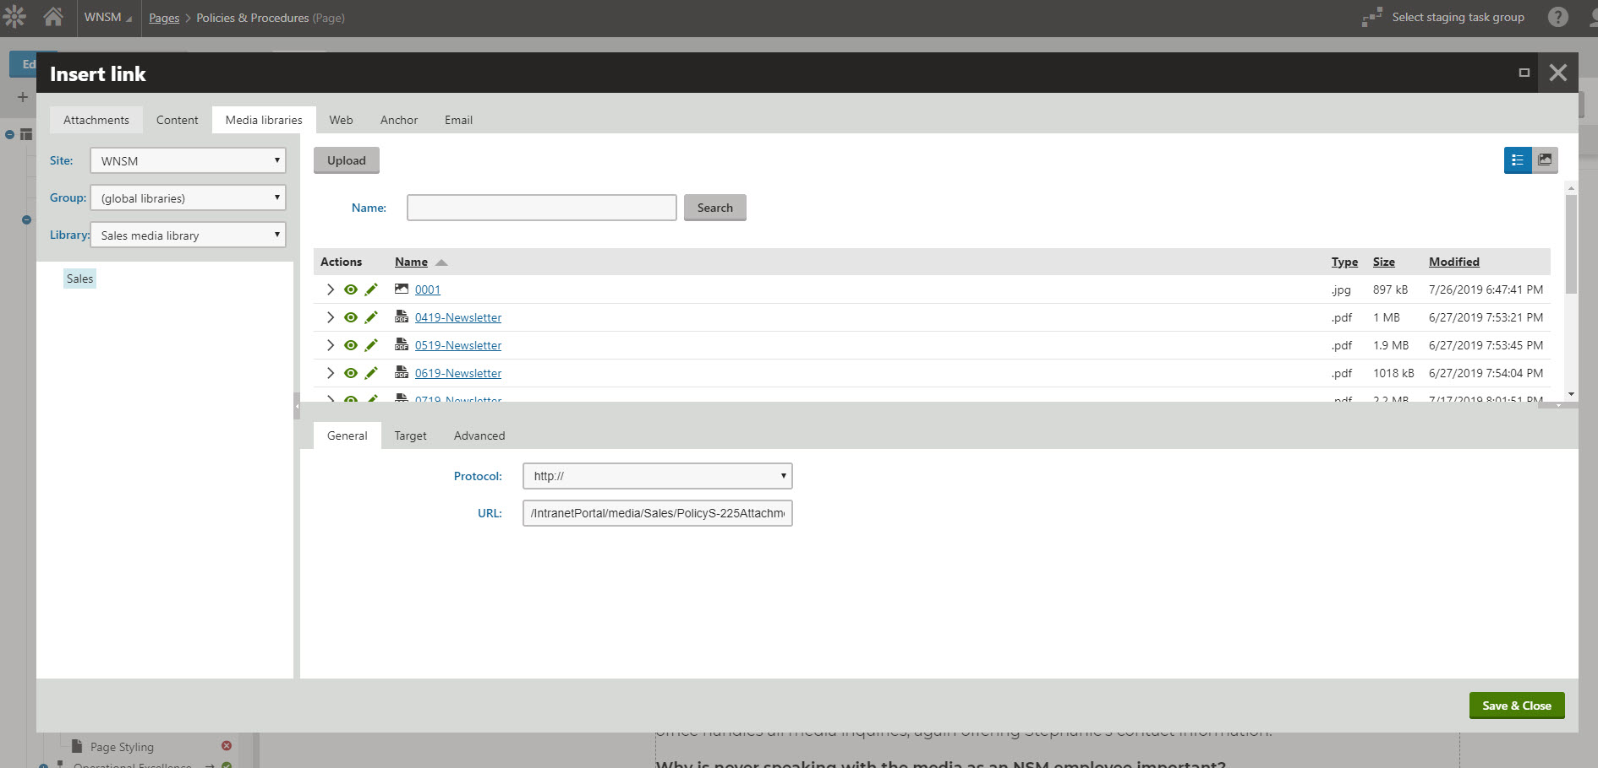
Adding Links + Files to Page
Within the Page tab, highlight the text you would like to add a link or file to
Click the link button and choose your desired link/file type.
Web = external web link
Media Libraries = file or attachment
For web, paste in link and click Save
For Media Libraries, click Upload, choose your file in the pop up, wait for it to load, click Save

Slide 12
Attachment Best Practices
Files should be named according to the following naming structure:
Department Name-File Name-Version-Date-First Initial Last Name
Always set the Target as New window (_blank) – this will ensure your document opens in a new window.

Slide 13
3
Content Styling

Slide 14
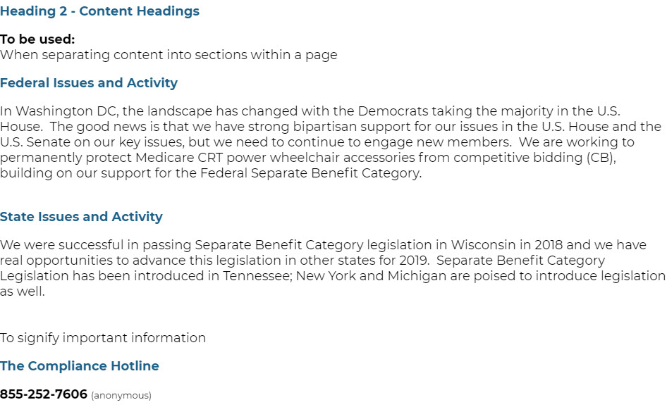
Page Styling
The styling menu will appear on the Page tab when you click into the editable text box
From here you can style the text, created numbered and bulleted lists, align your text, add links, and add images and videos.
Please follow these guidelines for styling text:

Slide 15
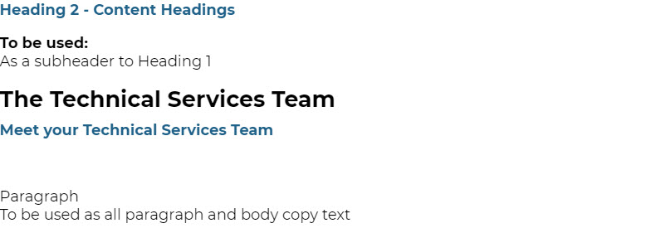
Page Styling
Please follow these guidelines for styling text:

